Slide 1
Objectives
  Define titles and footnotes to enhance reports.
  Define descriptive column headings.
  Use SAS system options.

Slide 2
Defining Titles and Footnotes
You use titles and footnotes to enhance reports.
General form of the TITLE statement:
TITLEn 'text ';
General form of the FOOTNOTE statement:
FOOTNOTEn 'text ';
Examples:
title1 'Flight Crew Employee Listing';
footnote2 'Employee Review';

Slide 3
Defining Titles and Footnotes
Features of titles:
  Titles appear at the top of the page.
  The default title is The SAS System.
  The value of n can be from 1 to 10.
  An unnumbered TITLE is equivalent to TITLE1.
  Titles remain in effect until they are changed, cancelled, or you end your SAS session.
  The null TITLE statement, title;, cancels all titles.

Slide 4
Defining Titles and Footnotes
Features of footnotes:
  Footnotes appear at the bottom of the page.
  No footnote is printed unless one is specified.
  The value of n can be from 1 to 10.
  An unnumbered FOOTNOTE is equivalent to FOOTNOTE1.
  Footnotes remain in effect until they are changed, cancelled, or you end your SAS session.
  The null FOOTNOTE statement, footnote;, cancels all footnotes.

Slide 5
Changing Titles and Footnotes
TITLEn or FOOTNOTEn
  replaces a previous title or footnote with the same number
  cancels all titles or footnotes with higher numbers.

Slide 6
Defining Titles and Footnotes
PROC PRINT Code
Resultant Title(s)
proc print data=work.march;
title1 'The First Line';
title2 'The Second Line';
run;
proc print data=work.march;
title2 'The Next Line';
run;
proc print data=work.march;
title 'The Top Line';
run;
proc
print data=work.march;
title3 'The Third Line';
run;
proc print data=work.march;
title;
run;

Slide 7
Defining Titles and Footnotes
PROC PRINT Code
Resultant Title(s)
proc print data=work.march;
The First Line
title1 'The First Line';
The Second Line
title2 'The Second Line';
run;
proc print data=work.march;
title2 'The Next Line';
run;
proc print data=work.march;
title 'The Top Line';
run;
proc
print data=work.march;
title3 'The Third Line';
run;
proc print data=work.march;
title;
run;
...

Slide 8
Defining Titles and Footnotes
PROC PRINT Code
Resultant Title(s)
proc print data=work.march;
The First Line
title1 'The First Line';
The Second Line
title2 'The Second Line';
run;
proc print data=work.march;
The First Line
title2 'The Next Line';
The Next Line
run;
proc print data=work.march;
title 'The Top Line';
run;
proc
print data=work.march;
title3 'The Third Line';
run;
proc print data=work.march;
title;
run;
...

Slide 9
Defining Titles and Footnotes
PROC PRINT Code
Resultant Title(s)
proc print data=work.march;
The First Line
title1 'The First Line';
The Second Line
title2 'The Second Line';
run;
proc print data=work.march;
The First Line
title2 'The Next Line';
The Next Line
run;
proc print data=work.march;
The Top Line
title 'The Top Line';
run;
proc
print data=work.march;
title3 'The Third Line';
run;
proc print data=work.march;
title;
run;
...

Slide 10
Defining Titles and Footnotes
PROC PRINT Code
Resultant Title(s)
proc print data=work.march;
The First Line
title1 'The First Line';
The Second Line
title2 'The Second Line';
run;
proc print data=work.march;
The First Line
title2 'The Next Line';
The Next Line
run;
proc print data=work.march;
The Top Line
title 'The Top Line';
run;
proc
print data=work.march;
The Top Line
title3 'The Third Line';
run;
The Third Line
proc print data=work.march;
title;
run;
...

Slide 11
Defining Titles and Footnotes
PROC PRINT Code
Resultant Title(s)
proc print data=work.march;
The First Line
title1 'The First Line';
The Second Line
title2 'The Second Line';
run;
proc print data=work.march;
The First Line
title2 'The Next Line';
The Next Line
run;
proc print data=work.march;
The Top Line
title 'The Top Line';
run;
proc
print data=work.march;
The Top Line
title3 'The Third Line';
run;
The Third Line
proc print data=work.march;
title;
run;
...

Slide 12
Assigning Column Labels
General form of the LABEL statement:
'label' specifies a label up to 256 characters.
Labels are used
  to replace variable names in SAS output
  automatically by many procedures
  by the PRINT procedure when the LABEL or SPLIT= option is specified in the PROC PRINT statement.
LABEL variable='label'
variable='label';

Slide 13
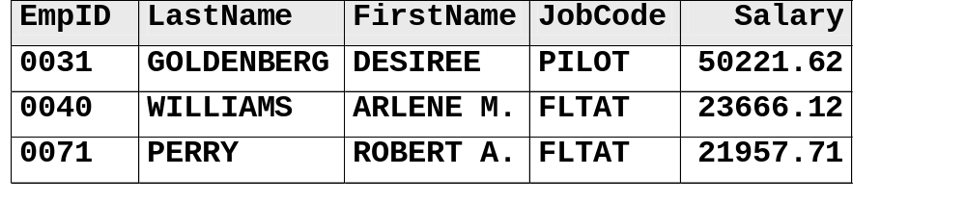
Assigning Column Labels
ia.empdata
PROC Step
proc print data=ia.empdata label;
label LastName='Last Name'
FirstName='First Name'
Salary='Annual Salary';
title1 'Salary Report';
run;
Salary Report
Emp First Job Annual
Obs ID Last Name Name Code Salary
1 0031 GOLDENBERG DESIREE PILOT 50221.62
2 0040 WILLIAMS ARLENE M. FLTAT 23666.12
3 0071 PERRY ROBERT A. FLTAT 21957.71
c05s1d1

Slide 14
Assigning Column Labels
ia.empdata
PROC Step
proc print data=ia.empdata split=' ';
label LastName='Last Name'
FirstName='First Name'
Salary='Annual Salary';
title1 'Salary Report';
run;
Salary Report
Emp Last First Job Annual
Obs ID Name Name Code Salary
1 0031 GOLDENBERG DESIREE PILOT 50221.62
2 0040 WILLIAMS ARLENE M. FLTAT 23666.12
3 0071 PERRY ROBERT A. FLTAT 21957.71
c05s1d2

Slide 15
Using SAS System Options
You can use SAS system options to change the appearance of a report.
General form of the OPTIONS statement:
The OPTIONS statement is not usually included in a PROC or DATA step.
OPTIONS option . . . ;

Slide 16
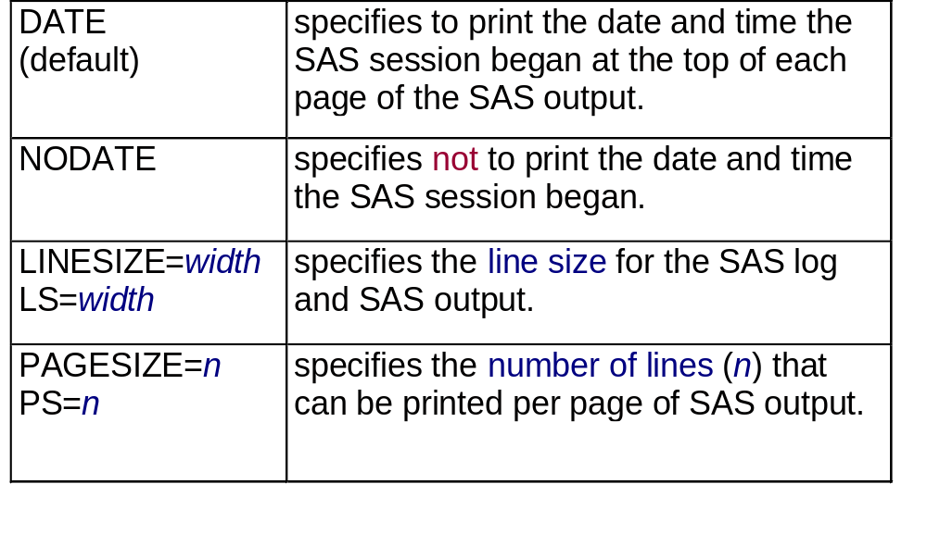
Using SAS System Options
Selected SAS system options:

Slide 17
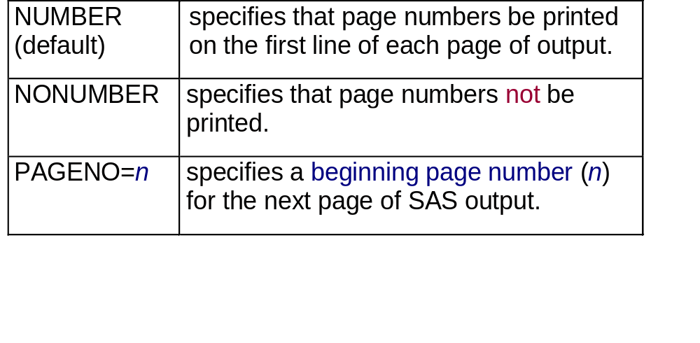
Using SAS System Options
Selected SAS system options:
Example:
options nodate nonumber ls=72;

Slide 18
Section 5.2
Formatting Data Values

Slide 19
Objectives
  Display formatted values using SAS formats in a list report.
  Create user-defined formats using the FORMAT procedure.
  Apply user-defined formats to variables
  in a list report.

Slide 20
Using SAS Formats
Enhance the readability of reports by formatting the data values.
Salary Report
Emp Last First Job Annual
Obs ID Name Name Code Salary
1 0031 GOLDENBERG DESIREE PILOT $50,221.62
2 0040 WILLIAMS ARLENE M. FLTAT $23,666.12
3 0071 PERRY ROBERT A. FLTAT $21,957.71
4 0082 MCGWIER-WATTS CHRISTINA PILOT $96,387.39
5 0091 SCOTT HARVEY F. FLTAT $32,278.40
6 0106 THACKER DAVID S. FLTAT $24,161.14
7 0355 BELL THOMAS B. PILOT $59,803.16
8 0366 GLENN MARTHA S. PILOT $120,202.38

Slide 21
Using User-defined Formats
Create custom formats to recode data values in a report.
Salary Report in Categories
Emp Last First Annual
ID Name Name JobCode Salary
0031 GOLDENBERG DESIREE Pilot More than 50,000
0040 WILLIAMS ARLENE M. Flight Attendant Less than 25,000
0071 PERRY ROBERT A. Flight Attendant Less than 25,000
0082 MCGWIER-WATTS CHRISTINA Pilot More than 50,000
0091 SCOTT HARVEY F. Flight Attendant 25,000 to 50,000
0106 THACKER DAVID S. Flight Attendant Less than 25,000
0355 BELL THOMAS B. Pilot More than 50,000
0366 GLENN MARTHA S. Pilot More than 50,000

Slide 22
Formatting Data Values
You can enhance reports by using SAS formats to format data values.
SAS
Data Set
Format
Report
Values in the SAS data set are not changed.

Slide 23
Formatting Data Values
To apply a format to a specific SAS variable, use the FORMAT statement.
General form of the FORMAT statement:
Example:
FORMAT variable(s) format;
proc print data=ia.empdata;
format Salary dollar11.2;
run;

Slide 24
What Is a SAS Format?
A format is an instruction that SAS uses to write data values.
SAS formats have the following form:
<$>format<w>.<d>
Indicates a character format
Number of decimal places
Required delimiter
Format name
Total width (including decimal places and special characters)

Slide 25
SAS Formats
Selected SAS formats:
w.d standard numeric format
8.2 Width=8, 2 decimal places: 12234.21
$w. standard character format
$5. Width=5: KATHY
COMMAw.d commas in a number
COMMA9.2 Width=9, 2 decimal places: 12,234.21
DOLLARw.d dollar signs and commas in a number
DOLLAR10.2 Width=10, 2 decimal places: $12,234.21

Slide 26
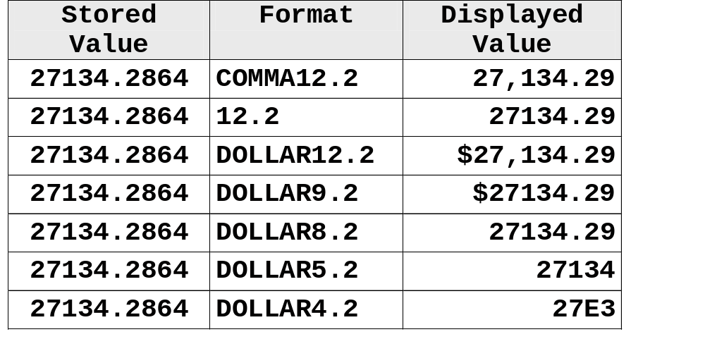
SAS Formats
If you do not specify a format width large enough to accommodate a numeric value, the displayed value is automatically adjusted to fit into the width.

Slide 27
Formatting Data Values
ia.empdata
PROC Step
proc print data=ia.empdata split=' ';
label LastName='Last Name'
FirstName='First Name'
Salary='Annual Salary';
format Salary dollar11.2;
title1 'Salary Report';
run;
Salary Report
Emp Last First Job Annual
Obs ID Name Name Code Salary
1 0031 GOLDENBERG DESIREE PILOT $50,221.62
2 0040 WILLIAMS ARLENE M. FLTAT $23,666.12
3 0071 PERRY ROBERT A. FLTAT $21,957.71
c05s2d1

Slide 28
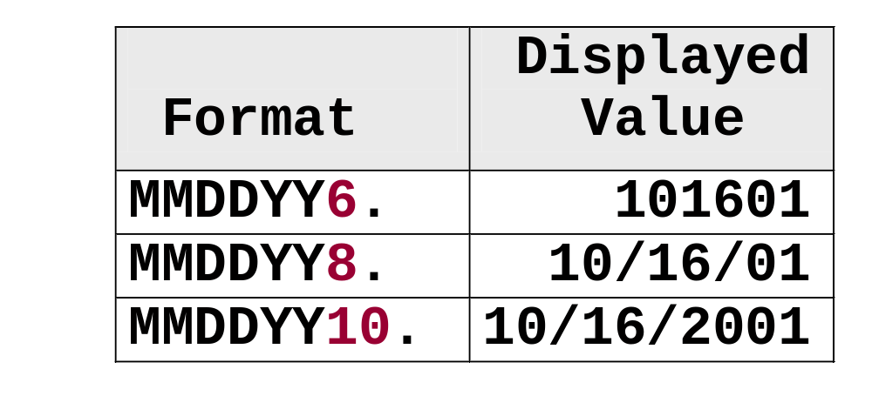
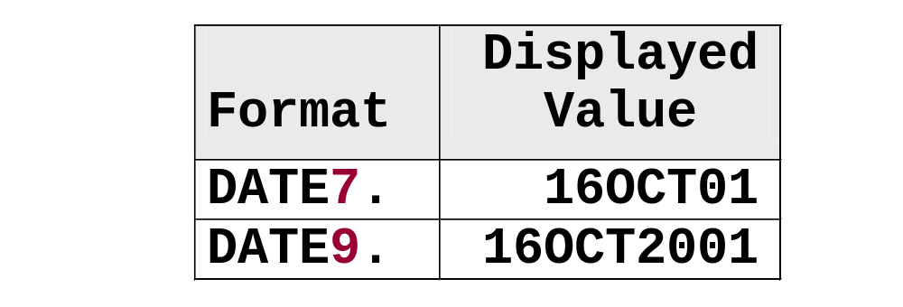
SAS Formats
Recall that a SAS date is stored as the number of days between 01JAN1960 and the specified date.
SAS date formats display SAS date values in standard date forms.
Selected SAS date formats:
MMDDYYw.
DATEw.

Slide 29
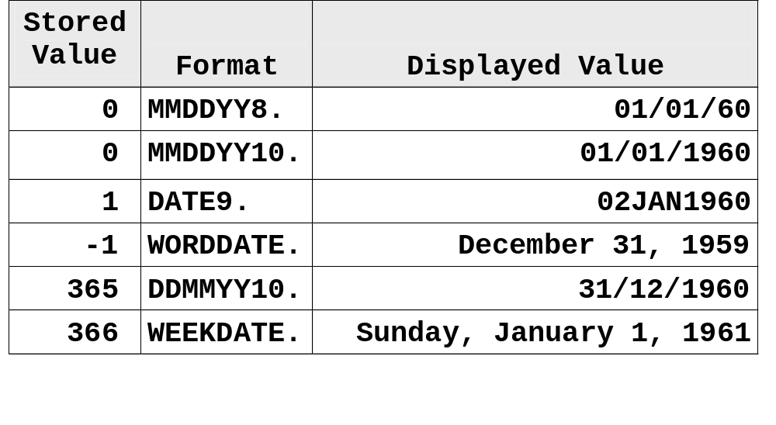
SAS Formats
Examples:

Slide 30

Exercises
These exercises reinforce the concepts discussed previously.

Slide 31
Creating User-defined Formats
SAS also provides the FORMAT procedure, which enables you to define custom formats.
To create and use your own formats,
  1. use the FORMAT procedure to create the format
  2. apply the format to specific variable(s)
  by using a FORMAT statement.

Slide 32
Creating User-defined Formats
General form of a PROC FORMAT step:
PROC FORMAT;
VALUE format-name range1='label '
range2='label '
. . . ;
RUN;

Slide 33
Creating User-defined Formats
Format-name
  names the format you are creating
  cannot be more than 32 characters in SAS System 9
  for character values, must have a dollar sign ($) as the first character, a letter or underscore as the second character
  for numeric values, must have a letter or underscore as the first character
  cannot end in a number
  cannot be the name of a SAS format
  does not end with a period in the VALUE statement.

Slide 34
Creating User-defined Formats
Labels
  can be up to 32,767 characters in length
  are typically enclosed in quotes, although it is not required.
Range(s)
  can be single values
  ranges of values.

Slide 35
Creating User-defined Formats
Assign labels to single numbers.
Formatted value
proc format;
value gender 1='Female'
2='Male'
other='Miscoded';
run;
Numeric format name
Numeric data value
Keyword

Slide 36
Creating User-defined Formats
Assign labels to ranges of numbers.
Keyword
proc format;
value boardfmt low-49='Below'
50-99='Average'
100-high='Above Average';
run;
Numeric data ranges

Slide 37
Creating User-defined Formats
Assign labels to character values and ranges of character values.
Character format name
proc format;
value $grade 'A'='Good'
'B'-'D'='Fair'
'F'='Poor'
'I','U'='See Instructor'
other='Miscoded';
run;
Character value range
Discrete character values
Keyword

Slide 38
Creating User-defined Formats
Step 1: Create the format.
proc format;
value $codefmt 'FLTAT'='Flight Attendant'
'PILOT'='Pilot';
run;
$codefmt
Step 2: Apply the format.
proc print data=ia.empdata;
format JobCode $codefmt.;
run;

Slide 39
Creating User-defined Formats
Step 1: Create the format.
proc format;
value money low-<25000 ='Less than 25,000'
25000-50000='25,000 to 50,000'
50000<-high='More than 50,000';
run;
Step 2: Apply the format.
money
proc print data=ia.empdata;
format Salary money.;
run;

Slide 40
Creating User-defined Formats
You can use multiple VALUE statements in a single PROC FORMAT step.
proc format;
value $codefmt 'FLTAT'='Flight Attendant'
'PILOT'='Pilot';
value money low-<25000 ='Less than 25,000'
25000-50000='25,000 to 50,000'
50000<-high='More than 50,000';
run;
c05s2d2

Slide 41
Applying User-defined Formats
proc print data=ia.empdata split=' ' noobs;
label LastName='Last Name'
FirstName='First Name'
Salary='Annual Salary';
format Jobcode $codefmt. Salary money.;
title1 'Salary Report in Categories';
run;
Salary Report in Categories
Emp Last First Annual
ID Name Name JobCode Salary
0031 GOLDENBERG DESIREE Pilot More than 50,000
0040 WILLIAMS ARLENE M. Flight Attendant Less than 25,000
0071 PERRY ROBERT A. Flight Attendant Less than 25,000
0082 MCGWIER-WATTS CHRISTINA Pilot More than 50,000
0091 SCOTT HARVEY F. Flight Attendant 25,000 to 50,000
0106 THACKER DAVID S. Flight Attendant Less than 25,000
0355 BELL THOMAS B. Pilot More than 50,000
0366 GLENN MARTHA S. Pilot More than 50,000

Slide 42
Exercises
These exercises reinforce the concepts discussed previously.

Slide 43
Section 5.3
Creating HTML Reports

Slide 44
Objectives
  Create HTML reports using the Output Delivery System (ODS).

Slide 45
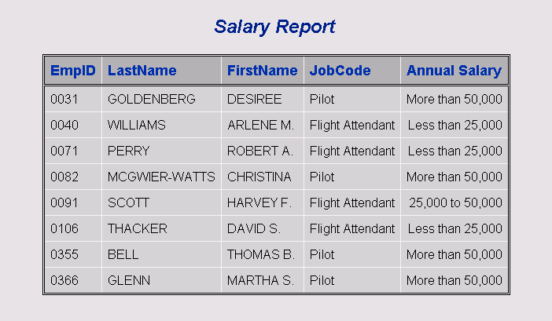
Business Task
Display a listing report in HTML form.

Slide 46
The Output Delivery System
ODS statements enable you to create output in a variety of forms.
SAS Output Window
ODS
HTML
SAS
Report
File
Printer
Other

Slide 47
Generating HTML Files
The ODS HTML statement opens, closes, and manages the HTML destination.
General form of the ODS HTML statement:
ODS HTML FILE='HTML-file-specification' <options>;
SAS code that generates output
ODS HTML CLOSE;

Slide 48
Generating HTML Files
Output is directed to the specified HTML file until you
  close the HTML destination
  specify another destination file.
HTML File
ods html file='…';
proc print…
proc means…
proc freq…
ods html close;
report
report
report

Slide 49
Creating an HTML Report
1. Open an HTML destination for the listing report.
2. Generate the report.
3. Close the HTML destination.
ods html file='c05s3d1.html';
proc print data=ia.empdata label noobs;
label Salary='Annual Salary';
format Salary money. Jobcode $codefmt.;
title1 'Salary Report';
run;
ods html close;
c05s3d1

Slide 50
Creating an HTML Report

Slide 51
Exercises
These exercises reinforce the concepts discussed previously.

